Slide 1
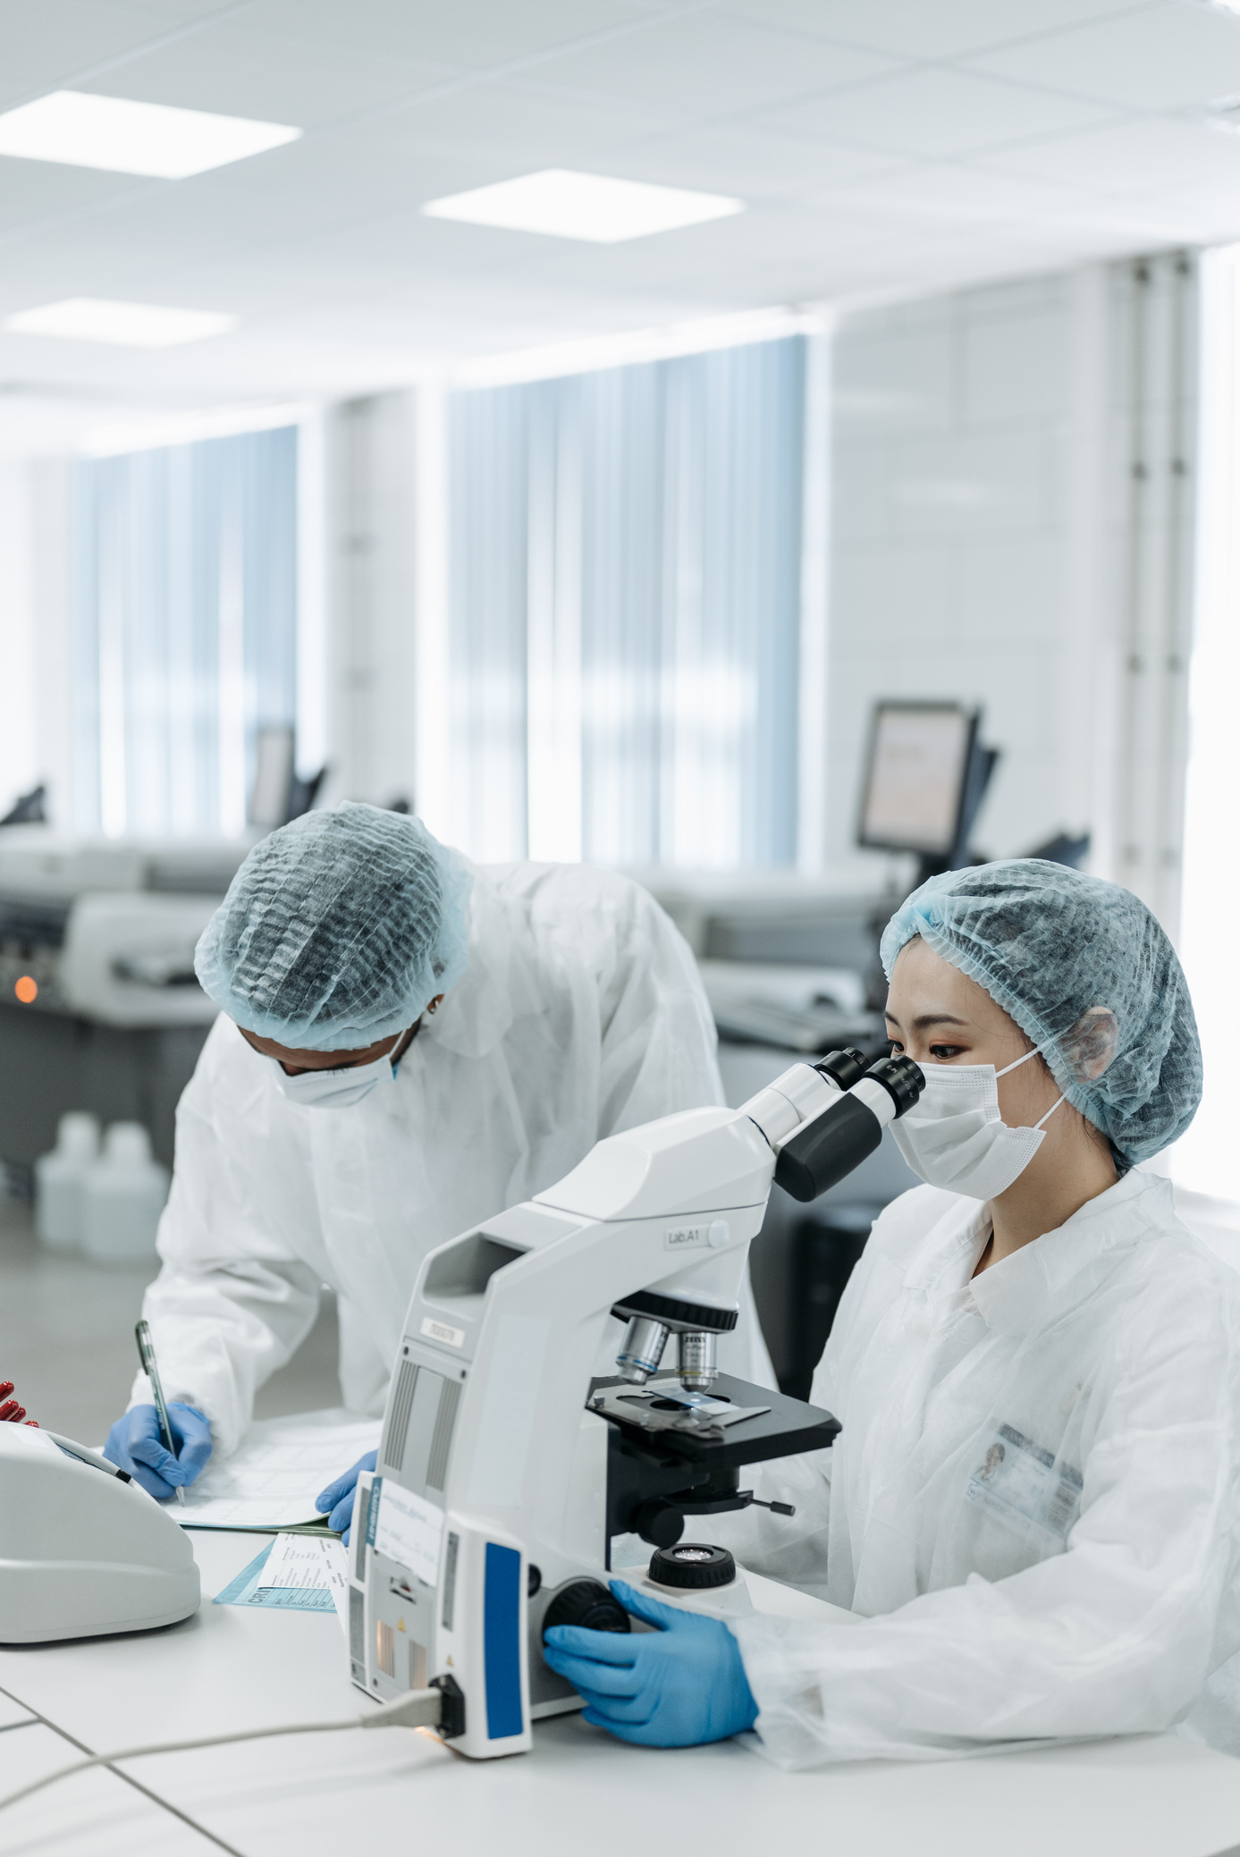

PNEUMONIA DETECTION FROM X-RAY
Improving Lives through Innovative Care
PRESENTED BY:
Nahidur Rahman

Slide 2


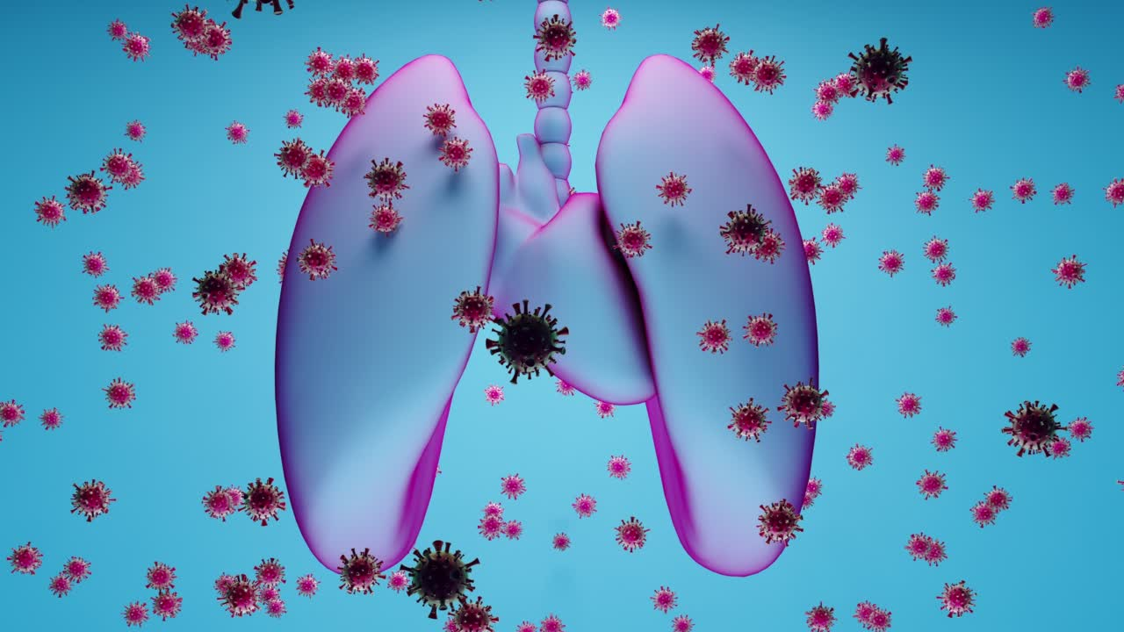
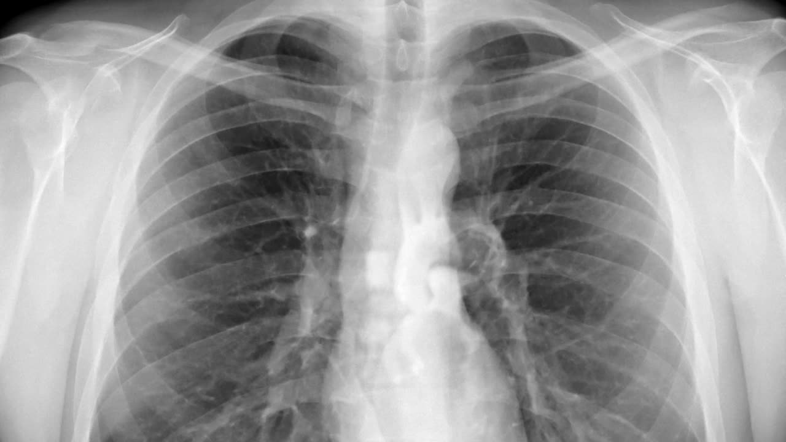

OBJECTIVE
To develop a machine learning model that accurately predicts pneumonia from chest X-ray images, aiding in faster and more reliable medical diagnosis.

Slide 3

SYSTEM OVERVIEW
Input
Upload image from local storage
Paste image using clipboard
Take a photo using phone or webcam
Backend Model
Convolutional Neural Network (CNN) model
Trained on a publicly available chest X-ray dataset (e.g., Kaggle Pneumonia Dataset)
Preprocessing includes resizing, normalization, and data augmentation
Model outputs Binary Classification:
Normal
Pneumonia
Output
Displays the predicted class (Normal or Pneumonia)
Provides a clear button to reset
Submit button triggers model prediction
Option to flag incorrect results

Slide 4

MODEL HIGHLIGHTS
Transfer Learning using models like ResNet, VGG16, or MobileNet for high accuracy
Accuracy achieved: ~95–98% (can vary depending on dataset)
Supports real-time use with interactive image input

Slide 5
MODEL WORKFLOW
Image Input: Uploaded or pasted X-ray
Preprocessing: Resize, normalize, augment
Model Prediction: CNN analyzes image
Output Display: Predicted label shown to user

Slide 6
ETHICAL CONSIDERATIONS
This tool is not a replacement for a radiologist.
Designed as a clinical decision support system.
Results should be verified by a qualified healthcare provider.

Slide 7

USE CASES
Fast screening in remote or low-resource areas
Educational tool for medical students
Integration in hospital radiology software

Slide 8

TECH STACK
Python, TensorFlow/Keras or PyTorch
Streamlit / Gradio for UI
OpenCV / PIL for image handling
Deployed locally or on cloud platforms (e.g., HuggingFace Spaces)

Slide 9
PERFORMANCE METRICS
Accuracy: ~95%
Precision: High on Pneumonia detection
Confusion Matrix used to evaluate class imbalance

Slide 10
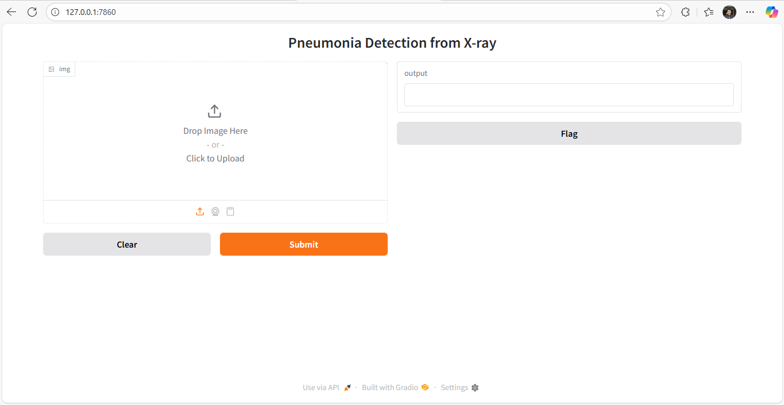
DEMO SNAPSHOT

Slide 11
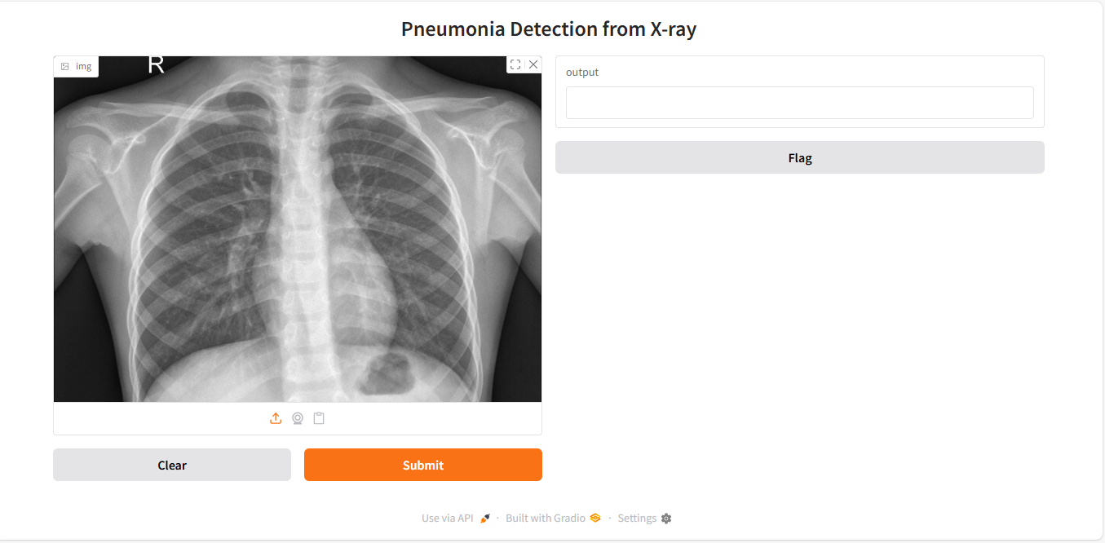
DEMO SNAPSHOT

Slide 12

DEMO SNAPSHOT

Slide 13
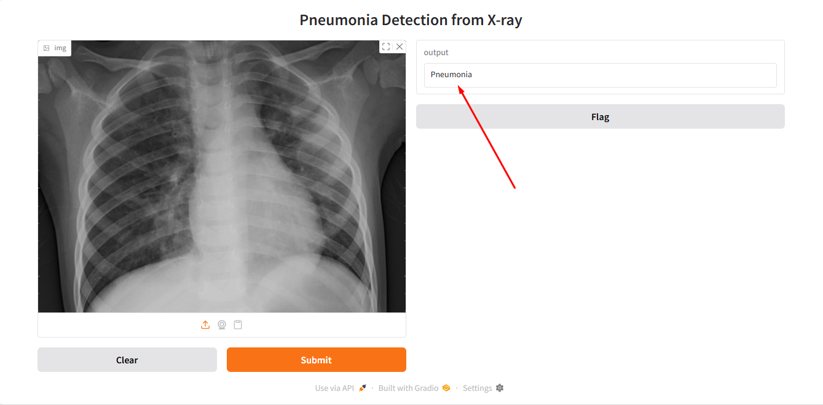
DEMO SNAPSHOT

Slide 14
THANK YOU

